Slide 1




MAJOR
PROJECT
R180996 - JHANSYSREENIVAS MANCHURI

Slide 2

Overview
Introduction
Background and Literature Review
Technologies Used
Data Collection
Machine Learning Algorithm
Training Model
Results
Future Enhancements
Conclusion
References

Slide 3


Introduction
Introducing the Kid Proximity Detection Project: a pioneering initiative leveraging advanced technologies to enhance child safety.
This project aims to create a robust system that alerts parents and caregivers when a child's proximity to potential dangers surpasses predefined thresholds, fostering a safer world for our most precious treasures.

Slide 4


Goals
Reliable Proximity Detection
Easy Integration Everywhere
Develop a system using technology to alert parents when their child is near potential dangers, ensuring constant monitoring for enhanced safety.
Create a user-friendly tool that effortlessly fits into homes, schools, and public spaces, making child safety practical and accessible for all.

Slide 5


Background and Literature Review
1
How do current safety measures for children lack real-time monitoring, and why is it a concern?
2
How can the Kid Proximity Detection Project use technologies like Machine Learning to improve child safety?
3
Why is it crucial for the Kid Proximity Detection system to be user-friendly and seamlessly integrated into daily routines?
4
What successes and challenges have been observed in projects related to child safety technologies?

Slide 6




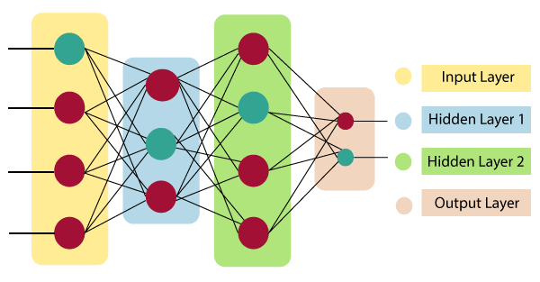
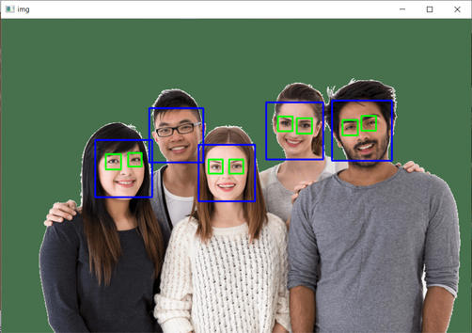
Technologies Used
Machine Learning:
TensorFlow and Keras are employed for developing, training, and evaluating machine learning models.
Computer Vision ToolBox:
OpenCV serves as a comprehensive computer vision library, contributing to image processing tasks such as face detection in the scripts .
Neural Network Architecture:
MobileNetV2, a convolutional neural network design optimized for mobile and embedded applications, functions as the underlying architecture in the script train_model.py for extracting features.
Haar cascades:
Haar Cascades are utilized for object detection, specifically faces, in both the scripts. Haar cascades act as classifiers identifying objects in images or video frames.

Slide 7
Data Collection
Gather a diverse set of images representing children and adults from various sources, ensuring a balanced distribution between classes for unbiased model training.
Manually annotate each collected image with the corresponding class label (child or adult) to create a labeled dataset, forming the foundation for supervised learning.
Prioritize privacy and ethical considerations during data collection, especially when obtaining images from individuals. Comply with privacy laws, obtain necessary consents, and implement security measures to safeguard collected data.

Slide 8
CNN ML Algorithm
Types Of ML
Algorithm
Why This?
CNN Algorithm:
The main machine learning algorithm used in this project is called MobileNetV2. MobileNetV2 is a type of convolutional neural network designed for tasks like image classification. In simpler terms, it's a smart system that learns to recognize whether an image contains a child or an adult, helping in Kid Proximity Detection.
MobileNetV2 was chosen because it's a smart and efficient technology. It works well for recognizing whether an image has a child or an adult, making it ideal for Kid Proximity Detection. Its efficiency and ability to adapt to specific tasks make it a good fit for this project.
There are a Total of 3 Types of Machine Learning Algorithms. They are:
Supervised Learning
Unsupervised Learning
Reinforcement Learning
The Algorithm that's been chosen comes under Supervised Learning.

Slide 9




Training Model
Learning from Data
Teach the system to recognize children and adults through training.
Importance of diverse dataset for accurate predictions in Kid Proximity Detection.
Enhanced Learning
Apply data augmentation techniques, such as rotation and flipping.
TensorFlow's ImageDataGenerator optimizes the model's understanding.
Efficient Model Training
Utilize MobileNetV2, a lightweight neural network.
Fine-tune specific layers for Kid Proximity Detection nuances, optimizing accuracy.

Slide 10

Results
Accuracy Achieved
Real-world Performance
Highlight the accuracy during training and testing phases.
Showcase improvements and the model's ability to generalize.
Summarize the model's performance in real-time scenarios.
Briefly discuss any observed efficiencies or areas for future improvement.

Slide 11
Future Enhancements
Our team
Using IOT to apply the model to Webcams
To Develop a Mobile App
Our future focus is directed towards crafting an intuitive mobile app, empowering parents and caregivers with seamless access to real-time insights and alerts from our Kid Proximity Detection system, fostering a safer environment for children.
In the future, we plan to use IoT technology to connect our Kid Proximity Detection system, making it smarter and more connected. This will give parents and caregivers timely alerts and insights, creating a safer and more interconnected system for child safety.

Slide 12



REFERENCES
Text Books :
Murphy, K. P. (2012). "Machine Learning: A Probabilistic Perspective."
Video lectures and tutorials on platforms like YouTube.

Slide 13

THANK YOU
For watching this presentation
7382197227 - S Nandini
6303412088 - I S Rizwan Raja
9392763867 - Jhansysreenivas Manchuri

